Slide 1
A Comprehensive Analysis of Sega Game Marketing: Integrating Data Insights with Business Knowledge
Nipith Wongsirikul

Slide 2
Proclaim
The purpose of this project is for self-learning.
The dataset being utilized contains numerous NULL values which impede its reliability for accurate analysis. Consequently, the findings may not reflect real-world data accurately.
This project leverages the capabilities of ChatGPT to enhance its analysis and professionalism.
The detailed components of the project, including code chunks and further documentation, are accessible via the following GitHub repository: https://github.com/GatipNW/Data.

Slide 3
Skills
This project serves as a testament to my diverse skill set, showcasing proficiency in the following areas:
R Programming language
SQL
Looker Studio
Tableau
Data Analysis
Business Insight
SWOT analysis
Generative AI (ChatGPT, etc.)

Slide 4
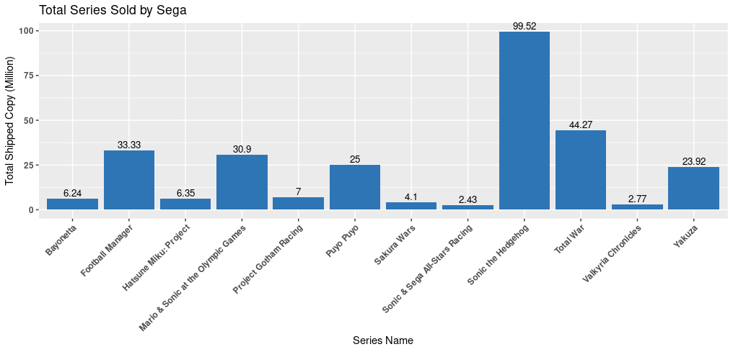
Sega Series Analysis by R
Analyze Sega series shipments worldwide, and plot the results on the left
Used R studio in Posit Cloud for analyst.
More detailed in RStudio_ View PDF at GitHub. (R Markdown notebook)
The data set is VGChartz from Kaggel

Slide 5
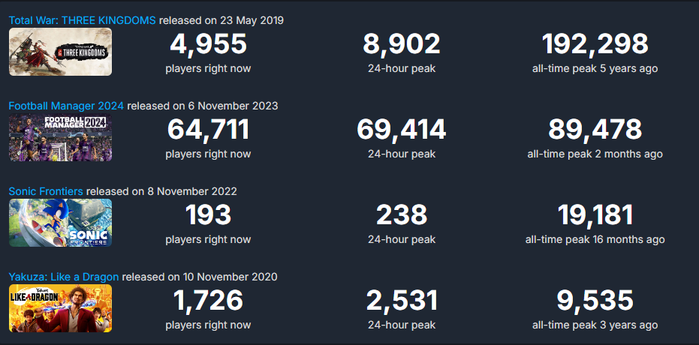
Sega Series : Reference
The following is the latest game released from the top 5 series, as per the database. The data is exclusively from the Steam platform for PC.
The data set is from streamdb

Slide 6
Sega Series Analysis : Key Takeaway
Sonic Series Dominance: The Sonic Series emerges as the quintessential symbol of Sega, mirroring the company's logo colors and serving as its flagship franchise. Sonic's sales rank as the top-selling Sega games, positioning it as a formidable contender comparable to Nintendo's iconic "Mario" franchise. This underscores Sonic's significance in the gaming industry and its ability to rival other major gaming franchises.
Strong Market Presence: Sega's portfolio of published series enjoys significant recognition and popularity within the gamer market. This indicates Sega's effectiveness in curating and promoting game series that resonate with gamers, contributing to its overall success and competitiveness in the gaming industry.

Slide 7

Sega Series Analysis : My Perspective
'Sonic Frontier' faces challenges despite effective marketing and promotion, including a demo version at TGS in Thailand.
The game struggles to captivate audiences due to a lack of gameplay depth and difficulty in identifying its target audience.
While Steam data indicates higher peak numbers for Sonic compared to Yakuza, a closer examination reveals Yakuza's current better performance.
Despite these challenges, 'Sonic Frontier' is considered a solid game overall.

Slide 8
Sega Series Analysis : My Perspective
Total War boasts strong and unique gameplay that sets it apart from other franchises, leading to a strong fanbase.
From a business standpoint, Total War: Three Kingdoms has performed well, even though the fanbase desires more content.
The introduction of Total War: Pharaoh is a strategic move to expand the fanbase and increase profitability.
Increased recognition of Sega's association with Total War could lead to higher profits for both entities.

Slide 9
Sega Series Analysis : My Perspective
Apart from the Sonic Series, the Yakuza series has gained significant recognition among gamers as a Sega publication.
Yakuza's compelling themes and time-investing gameplay have contributed to its enduring popularity.
The series is renowned for its juxtaposition of serious storytelling with humorous side stories, which has contributed to its fame.
However, some concern arises from the repetitive core gaming style across Yakuza 4-5-6, prompting a significant departure in Yakuza 7: Like a Dragon, which has been well-received.
While the Yakuza series may not achieve sales figures comparable to Total War or Football Manager, it embodies the essence of Sega's gaming identity.

Slide 10
Sega Series Analysis : My Perspective
Football Manager is undoubtedly the greatest football management game currently available.
A new competitor threatens to draw the fanbase away from Football Manager, but they have struggled to succeed in doing so.
Sega has a strong understanding of the sports genre, as evidenced by data.
If Football Manager avoids any major mistakes, it has the potential to generate significant profits in the long term, making it a safe bet.

Slide 11
Sega Yearly Sale Analysis : SQL
First I wrote a code in SQL below, For call the “Year” and “total sold” to sum it as total sold per year.
WITH Year_Sell AS (
SELECT *, EXTRACT(YEAR FROM date) AS year
FROM Game_Data_1.Game_Data_Table1
WHERE publisher = 'Sega'
)
SELECT
year,
ROUND(SUM(total), 2) AS total_yearly_sales_copy
FROM Year_Sell
GROUP BY year
HAVING SUM(total) IS NOT NULL
ORDER BY year DESC;

Slide 12
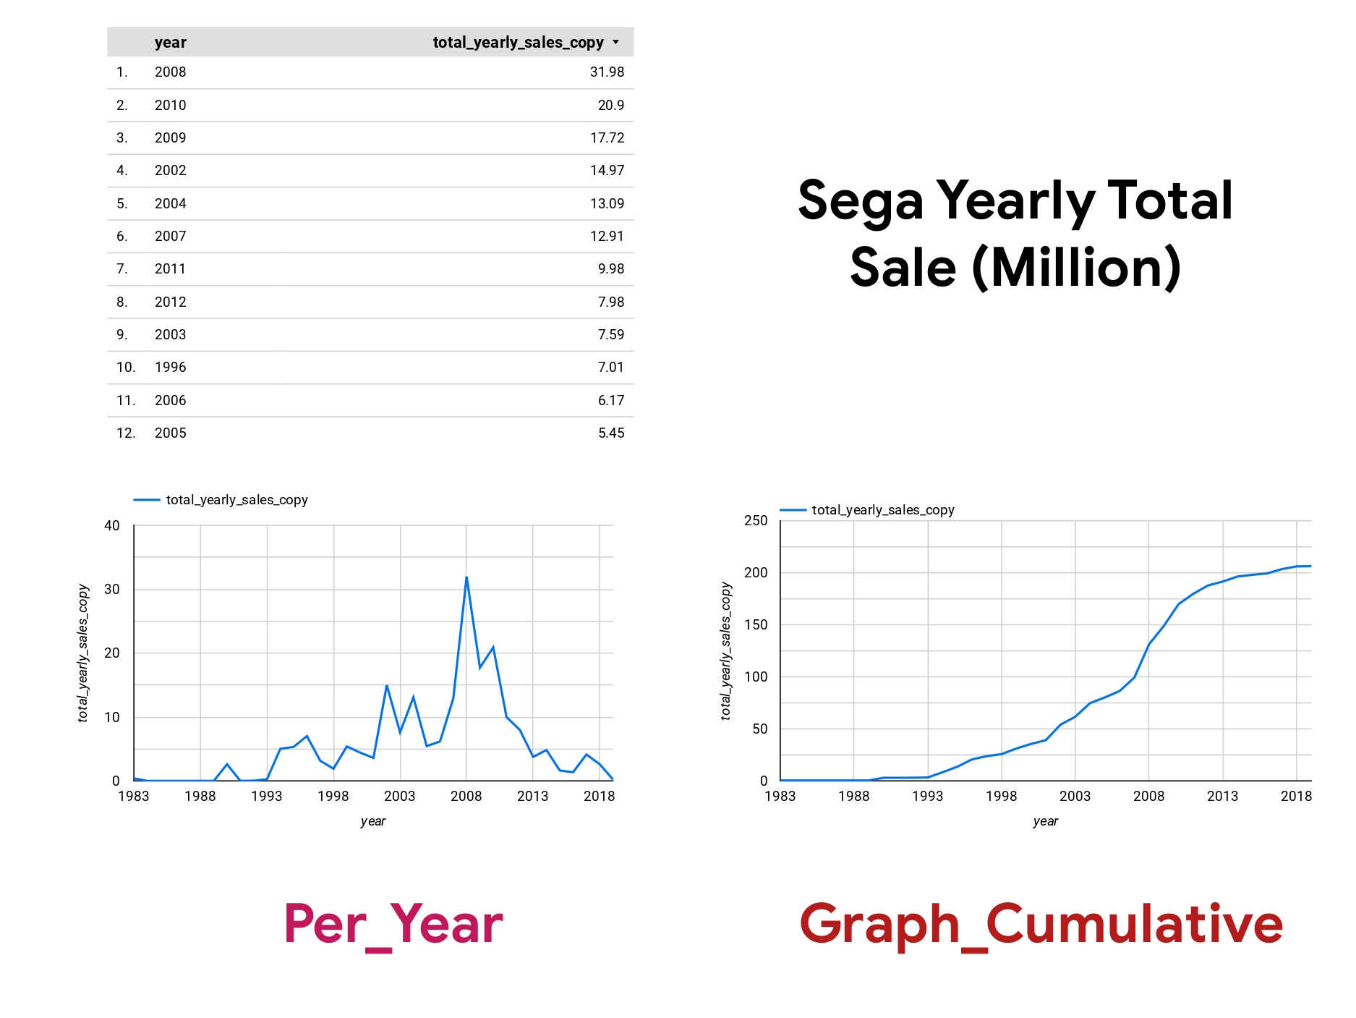
Sega Yearly Sale Analysis : Looker Studio
After that, I created a graph in Looker Studio. 'Per_Year' presents the total number of copies sold (in millions) per year, and 'Graph_cumulative' displays the cumulative total sales for each year.
More detailed in Looker_Studio_Reporting_-_1_3_24_17_31 at GitHub.
The data set is VGChartz from Kaggel

Slide 13
Sega Yearly Sale Analysis : Questions
Q. Is Sega doing good or bad in term of yearly sale? To gauge Sega's performance in terms of yearly sales, it's essential to conduct a comparative analysis with its direct competitors. Targeting renowned Japanese gaming companies with long-established histories like Bandai Namco, Konami, Capcom, Nintendo, and Square Enix provides a comprehensive benchmark for evaluating Sega's standing in the industry. By comparing Sega's sales trends with those of its competitors, we can gain insights into its relative performance and ascertain whether Sega is excelling or facing challenges in the market.

Slide 14
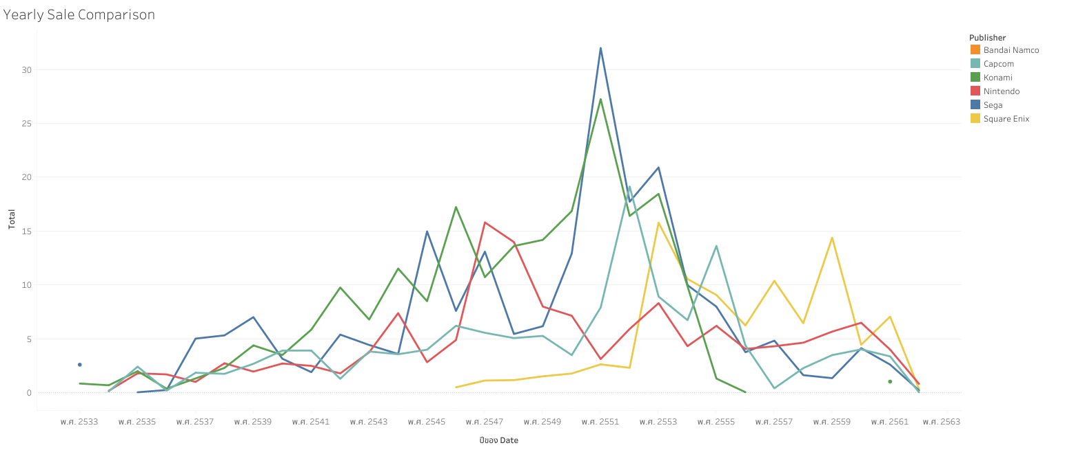
Yearly Sale Comparison : Tableau
The data set is VGChartz from Kaggel
*Due to a Tableau Public issue, my visualization is in Thai, with the year format automatically converted to the Thai calendar. I'm unable to fix this online, as I'm only familiar with the desktop version. However, I'll focus on the Thai year 2551, which equals 2008 AD.
AD formatting and full resolution : https://public.tableau.com/app/profile/nipith.wongsirikul/vizzes

Slide 15
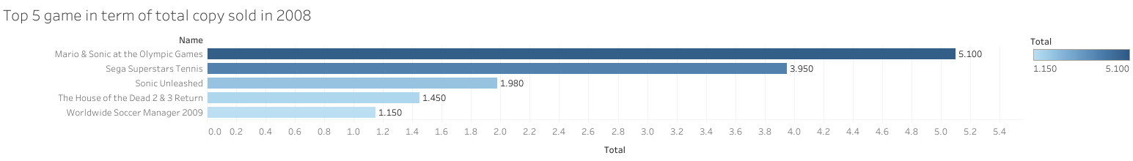
Sega Yearly Sale Analysis : 2008
full resolution : https://public.tableau.com/app/profile/nipith.wongsirikul/vizzes
In 2008, video game sales peaked, with Sega leading the pack compared to its competitors. To illustrate Sega's success, I created a bar graph in Tableau showcasing the top 5 best-selling games of 2008 that propelled Sega to the forefront. The results are displayed at the top.

Slide 16
Sega Yearly Sale Analysis : Key Takeaways
Sega reached its peak in 2008 AD, surpassing competitors and achieving the highest peak according to the database.
Despite its success in 2008, Sega faced a downturn afterward and struggled to compete with rivals.
Sonic and sports games were the highlights that propelled Sega to glory in 2008.

Slide 17
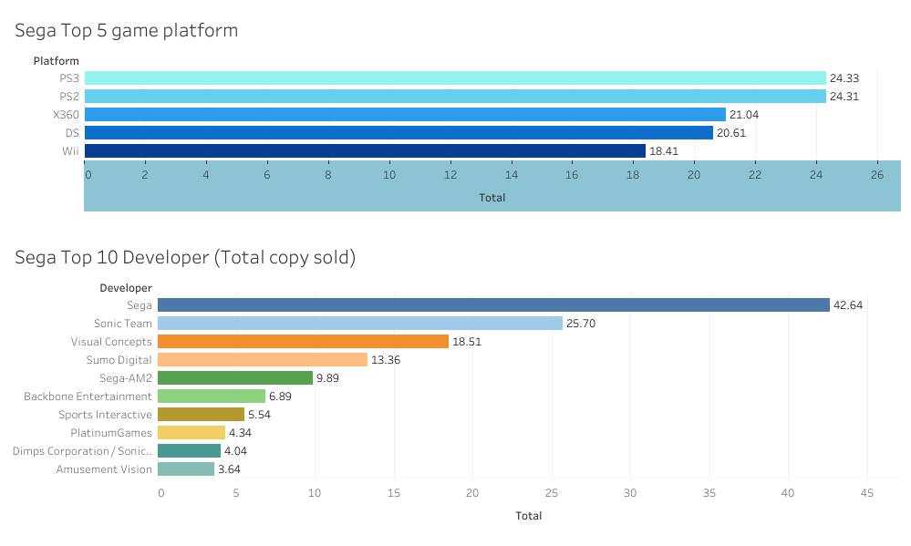
Sega Tableau : Additional
full resolution : https://public.tableau.com/app/profile/nipith.wongsirikul/vizzes

Slide 18
Sega SWOT Analysis : S
Strength
Renowned Company with a Long History and Diverse Series: This highlights Sega's reputation and extensive experience in the gaming industry, as well as its diverse portfolio of successful series. This history and breadth of offerings can contribute to brand loyalty and consumer trust.
Sonic as a Strong Brand Character: Sonic the Hedgehog is indeed a powerful brand for Sega, comparable to Nintendo's Mario. This emphasizes Sonic's significance as a key asset for Sega, contributing to brand recognition and market appeal.
Strong Structure and Resources: This strength suggests that Sega possesses robust organizational capabilities and financial resources, which are essential for sustaining operations, investing in innovation, and weathering challenges in the gaming industry.

Slide 19
Sega SWOT Analysis : W
Weaknesses
Declining Market Share: This weakness highlights Sega's struggle to maintain its market position amidst competition from other gaming companies. The mention of Japan-specific data adds specificity to the analysis, showing a localized decline in market presence.
Lack of Recent Hits: This weakness underscores Sega's difficulty in producing new blockbuster titles in recent years, despite having successful franchises. The observation that the existing franchises are from older times suggests a need for fresh, innovative content to drive revenue growth.
Dependency on Sonic: Sega's reliance on the Sonic the Hedgehog franchise for revenue is identified as a vulnerability. The inability of Sonic Frontier to become a flagship game further emphasizes the risks associated with depending on a single IP for financial success.

Slide 20
Sega SWOT Analysis : O
Opportunities
Expansion into Mobile Gaming: Sega can tap into the growing mobile gaming market by developing titles for smartphones and tablets, broadening its audience reach and revenue streams.
Emerging Markets: Sega has the opportunity to explore growing markets like China, India, and Southeast Asia, catering to increasing demand for gaming content and expanding its global presence.
VR and AR: Leveraging VR and AR technologies can enable Sega to create immersive gaming experiences, attracting new audiences and staying innovative in the gaming industry.
Generative AI: By embracing generative AI, Sega can streamline game development processes, create dynamic gaming experiences, and enhance player engagement, keeping pace with technological advancements and evolving player preferences.

Slide 21
Sega SWOT Analysis : T
Threats
Intense Competition: Sega faces tough competition from established and emerging gaming companies, requiring strategic differentiation to maintain market relevance.
Rapid Technological Advancements: Sega must invest in ongoing research and development to keep pace with technological advancements and remain competitive.
Economic Uncertainty: Fluctuations in consumer spending and economic conditions may impact Sega's sales and profitability, necessitating adaptable strategies to navigate uncertainties.

Slide 22
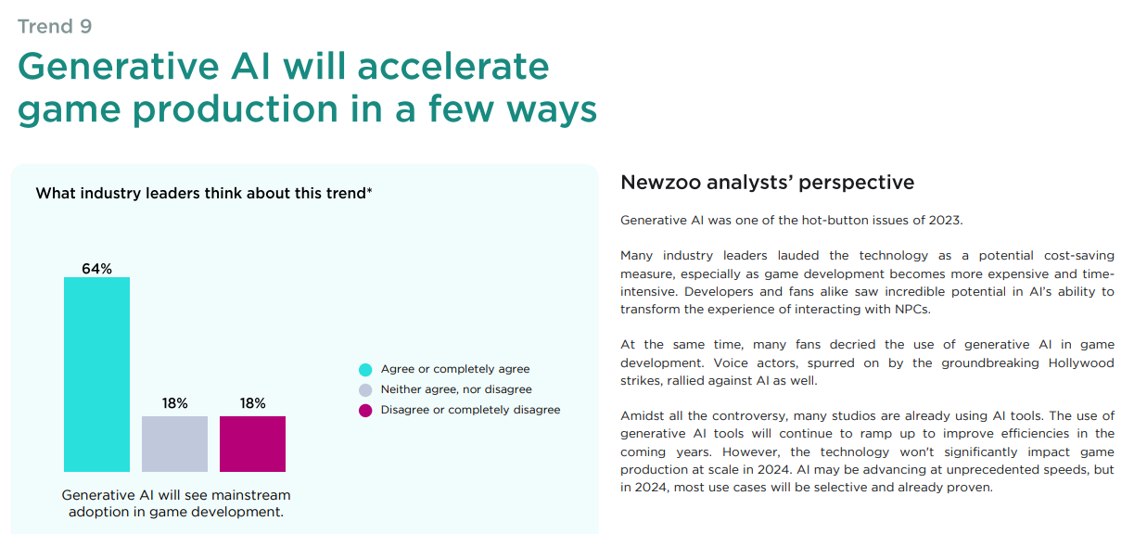
Sega SWOT : Reference Generative AI
According to newzoo the leading data partner for the game market, Game market trends to watch in 2024

Slide 23
Sega SWOT : Reference Generative AI
According to newzoo the leading data partner for the game market, Global Games Market Report 2024 January
PRO :
Generative AI revolutionizes AAA game development by reducing costs and streamlining processes.
Blizzard's Diffusion tool, utilizing generative AI, accelerates art asset creation, significantly cutting manual labor.
AI aids in prototyping and concept art, streamlining asset creation processes.
Emergence of AI-generated voices in games reduces reliance on voice actors, though concerns about job displacement exist.
AI may replace CGI and video production, modernizing older titles.
Long-term implications include user-generated content and RPGs evolving into infinite living worlds.
Generative AI offers innovation and cost efficiency, but questions remain about profitability and industry saturation.

Slide 24
Sega SWOT : Reference Generative AI
According to newzoo the leading data partner for the game market, Global Games Market Report 2024 January
CON :
Legal challenges arise with generative AI in game development due to potential copyright infringement.
Pushback from developers and gamers highlights ethical and legal concerns.
Valve bans games on Steam using AI-generated art assets, underscoring the need for regulation.
Regulation must define fair use of AI in game development to ensure legal compliance.
Generative AI promises to democratize game development, accelerate UGC and live services, and offer new gaming experiences.
Despite potential, widespread adoption requires regulatory frameworks and vigilance to address legal and ethical issues.

Slide 25
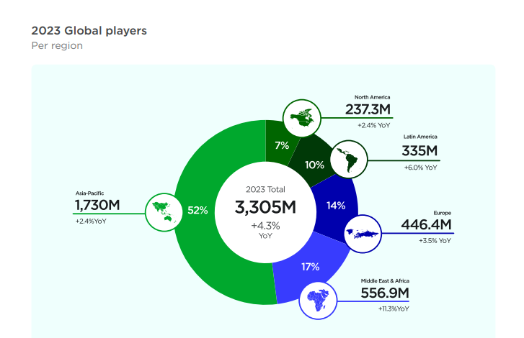
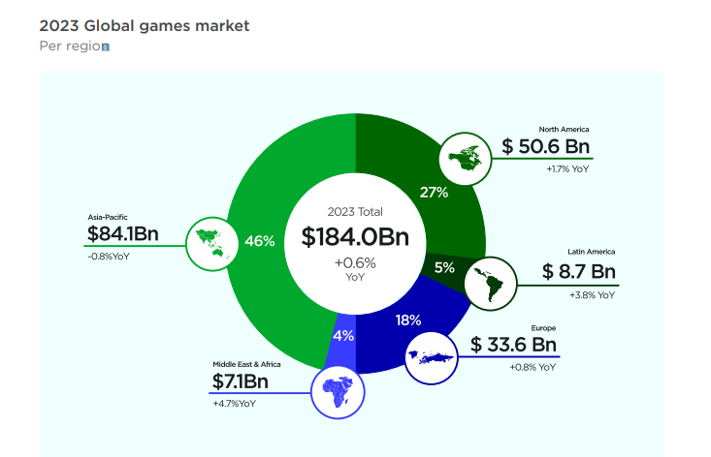
Sega SWOT : Reference SEA Market
According to newzoo the leading data partner for the game market, Global Games Market Report 2024 January

Slide 26
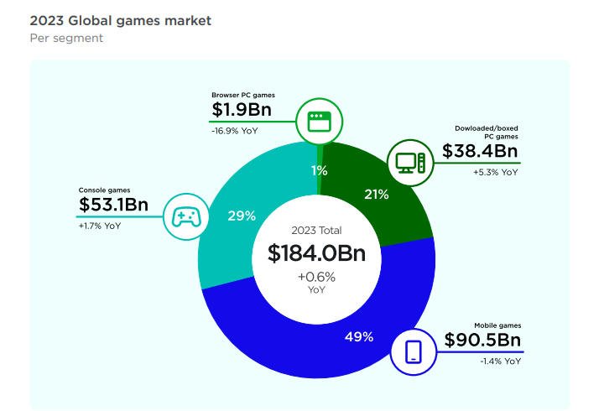
Sega SWOT : Reference Mobile Market
According to newzoo the leading data partner for the game market, Global Games Market Report 2024 January

Slide 27
Future project
Project with Game company that have Generative AI. (Database)
Data Modeling using AI. (AI)

